Slide 1
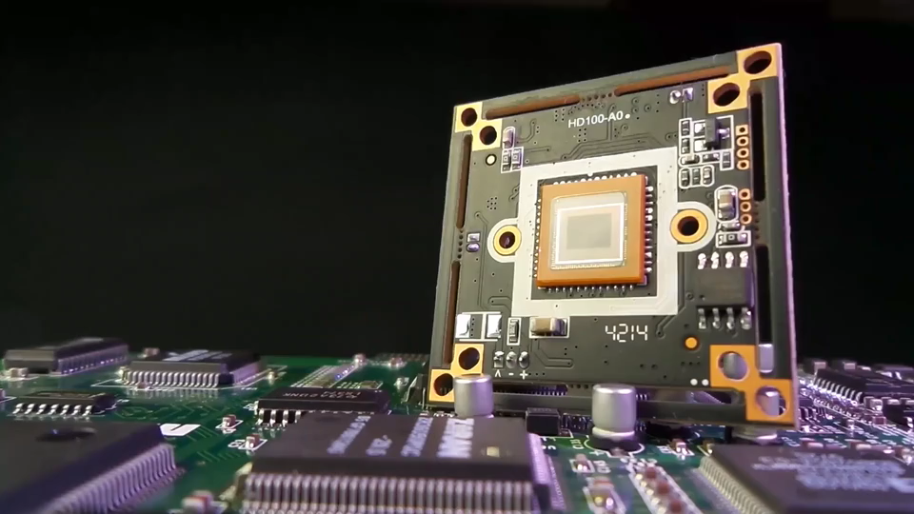


MS POWERPOINT

Slide 2

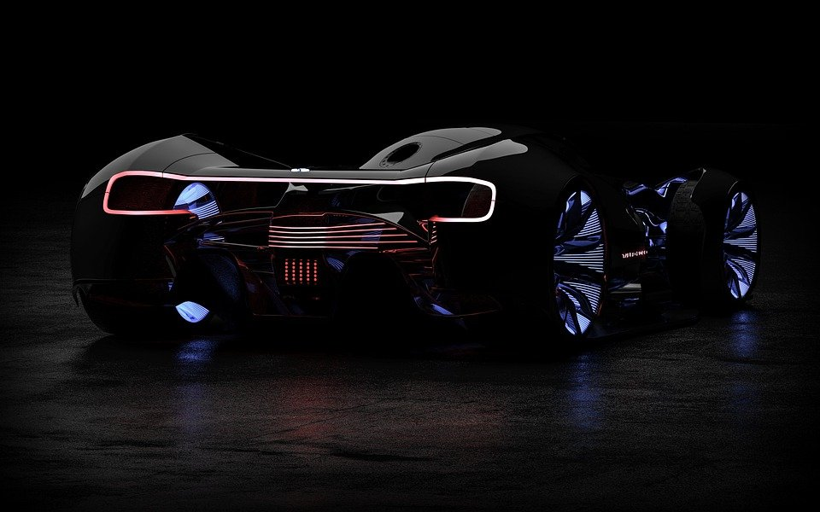
MS POWERPOINT
2021 or 365
PROJECT 2

Slide 3
ALIGNMENT
BOLD
BULLETS
FONT SIZE
FORMAT
LAYOUT
TEXT

Slide 4

POWERPOINT
PJ 2

Slide 5


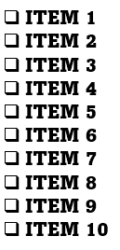
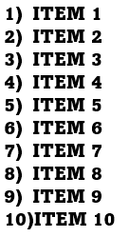
Create Bulleted and Numbered Lists
Alignment
Item 1
Item 2
Item 3
Item 4
Item 5
Item 6
Item 7
Item 8
Item 9
Item 10

Slide 6

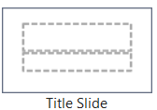
Layout
Insert Text on a Title Slide
Text 1
Text 2

Slide 7

Layout
Insert Text Box
on a Slide
Transform
Ring : Inside

Slide 8

Layout
Insert WordArt
Text on a Slide
Transform
Inflate

Slide 9

FORMAT
Text
Font
Bold
Transform
Triangle: UP

Slide 10

Apply WordArt Styles to Text

Slide 11
INSERT PICS & VIDEOS

Slide 12

Insert Picture background

Slide 13
Insert Video background

Slide 14


Slide 15


