Slide 1
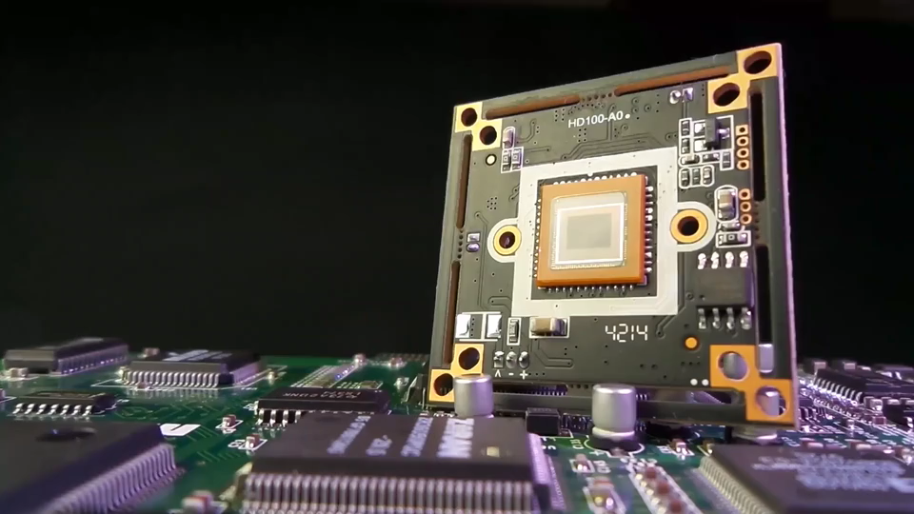


MS POWERPOINT

Slide 2


PowerPoint
Project 3
ANIMATIONS & TRANSITIONS

Slide 3
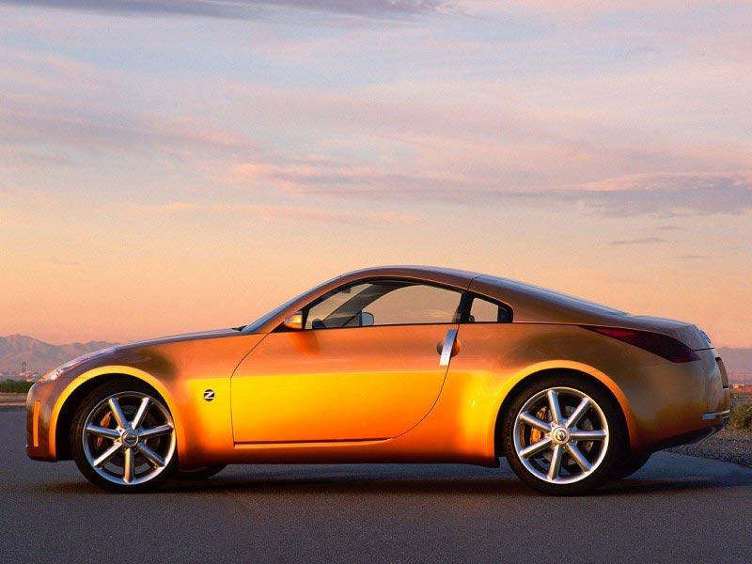

Slide 5


Slide 6
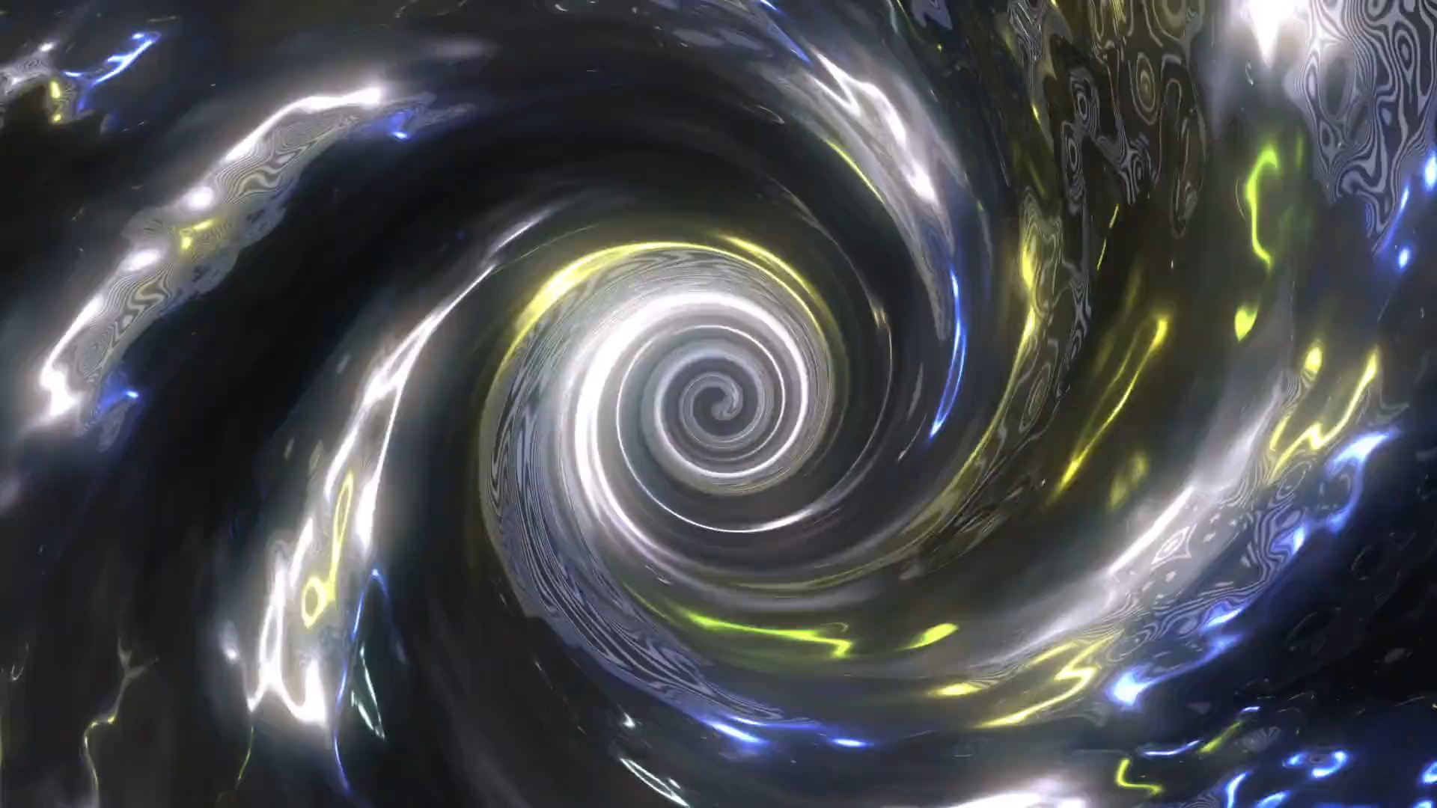

Slide 7


